Slide 1

Making this resource work for you
Prior to teaching this lesson, please refer to the ‘Unit Overview and Planning Document’.
Further guidance on planning Science Mastery lessons can be found in the detailed planning guidance document.
Refer to the ‘notes’ section on each slide for useful information, including suggested expositions, pedagogical content knowledge, suggested questions, answers and more. Consider using presenter mode so you can see this guidance throughout the lesson.
The introduction slides can be adapted to suit your teaching style and the needs of your class.
Before the lesson, adapt the fix-it slide to address any misconceptions identified in the previous lesson’s exit ticket.
Choose from the suggested activities to suit your class. The intention is not that you complete all of these, but that you select those which ones are most appropriate for your students. It may be appropriate to further adapt activities for your students.
These lessons are designed to occupy approximately 1 hour. To adapt for a shorter or longer lesson duration we advise you to adapt the activity section accordingly.
Please consider using the final slide to send feedback about this lesson or examples of PowerPoints that you have adapted to our design team. Your feedback is used to improve Science Mastery for all of our teachers and students. We appreciate all suggestions and comments.
Thank you for reading!
The Science Mastery Team

Slide 2

Resolving Vectors
15 N
Answer the following questions:
10 N
10 N
State the definition of a resultant vector.
State the definition of resultant force.
Describe how to calculate a resultant force when two forces are acting in the same direction.
Calculate the resultant force in the free-body force diagram above.
An object is moving at a steady speed. What can be said about the forces acting upon it?
The combination of two or more single vectors.
The net force or the overall effect of all the forces acting on an object.
The resultant force is the sum of the two forces.
15 N right
They must be balanced as only an unbalanced force can change the motion of an object.
Notes:
Foundation question: State the resultant force on a stationary object.
Stretch question: Explain why it is incorrect to say that if balanced forces are acting on an object it must be stationary.
Answers:
Foundation: 0 N
Stretch: Balanced forces mean the motion will not change, but the object could have been in motion already so balanced forces could also be acting on an object that is moving at a constant speed in the same direction (constant velocity).

Slide 3
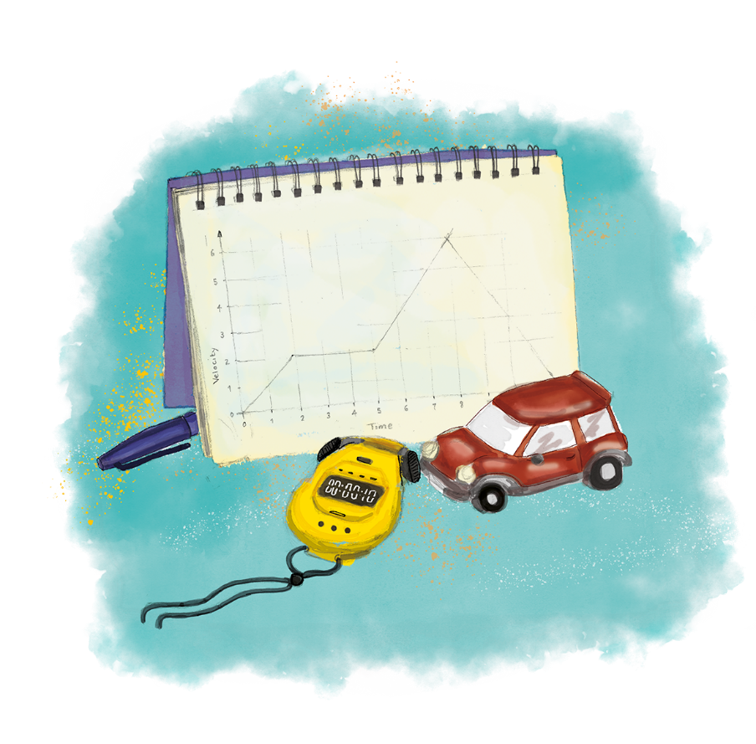


P3.1.4
01/05/2024
Resolving Vectors
P3.1.1 Prior Knowledge Review
P3.1.2 Scalars and Vectors
P3.1.3 Resultant Vectors
P3.1.4 Resolving Vectors
P3.1.5 Newton's Third Law
P3.1.6 Newton's First Law
P3.1.7 Acceleration
P3.1.8 Acceleration Investigation
Maths in Science Lesson 17
P3.1.9 Velocity-Time Graphs
P3.1.10 Velocity-Time Graphs 2
P3.1.11 Acceleration Problems
Notes:
In the last lesson pupils looked at how to determine the resultant of two vectors acting perpendicular to each other. In this lesson they will work backwards to resolve a resultant vector into its horizontal and vertical components. They will not learn to do this by calculation at this stage as many will not yet have covered trigonometric ratios, so teachers can choose to revisit this in P4.1, but it is sufficient for pupils to be able to determine resultants and components just by scale drawing.
Hook:
You could put a free-body force diagram on the board where the resultant force is at an angle of 60º. This is the resultant force of two children pulling the object, one pulling to the North and one pulling to the East (using the horizontal plane so we can ignore weight etc). How could we work backwards from this to see which child is pulling with more force?

Slide 4

Following this lesson, students will be able to:
Use scale drawings to determine the resultant of two vectors acting at an angle
Use scale drawings to resolve vectors into components
Key Words:
resultant
vector
scale
horizontal
vertical
component

Slide 5
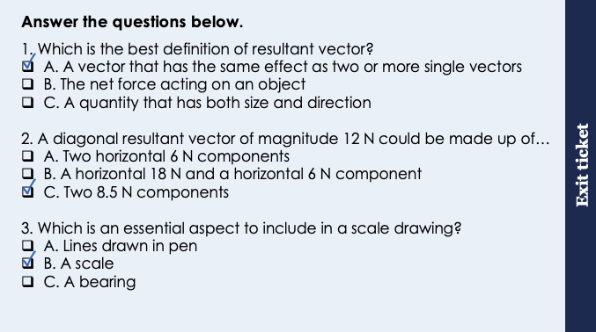
This is the fix-it portion of the lesson
The fix-it is an opportunity to respond to gaps in knowledge, especially those identified by the previous lesson’s exit ticket.
The teacher should customise this slide as needed, to facilitate
reteach, explanation, demonstration or modelling of ideas and concepts that students have not yet grasped or have misunderstood.
practise answering specific questions or of key skills.
redrafting or improving previous work.
Notes:
Suggested Guidance from previous exit ticket:
Q1. Answer: A
If students answer B they have confused resultant force and resultant vector, which is the broader class of quantities. If students answer C they have confused vector and resultant vector. To fix-it, pupils could write the definition of each and explain why they are not the same.
Q2. Answer: C
If students answer A or B they are not clear on how a diagonal vector is produced from horizontal and vertical components. To fix-it, it may be useful to go through the different scenarios with vectors being combined and show them this working mathematically – i.e. two vectors acting in the same direction will produce the maximum resultant vector, two acting in opposite directions would produce the minimum vector.
Q3. Answer: B
If students answer A or C they have not understood the key aspect of a scale drawing. To fix-it, they could use further practice drawing scale drawings (in pencil) and a further explanation that a bearing is not necessarily required if pupils have described the direction of the resultant vector with an angle already.

Slide 6
General Definition
Scientific Definition
Noun: part of a larger whole or thing.
From the Latin componere meaning ’putting together’.
A single horizontal or vertical vector.
A piece of equipment in an electrical circuit.
Component
‘The ability to be in the present moment is a major component of mental wellness,’
Abraham Maslow
General Examples
Synonyms
The main components of a pizza are dough, tomato and cheese.
Antonyms
Part
Piece
Bit
Section
Sum
Entirety
Scientific Examples
Resultant vectors acting at an angle are made up of horizontal and vertical components.
Electrical circuits are made up of components.
Notes:
Purpose of this slide:
The purpose of the Frayer organiser is to address key scientific vocabulary that students may be familiar with from a non-scientific context. Addressing this at the beginning of the lesson limits the potential cognitive conflict that might arise if students are using their current non-scientific interpretation of a term to understand the science being learned. This approach limits the potential for misconceptions and confusion arising from differing scientific and non-scientific uses of the same word.
The use of this slide is intended to clearly show students
how a word can have both scientific and non-scientific meanings simultaneously
the correct usage of a word in both a scientific and non-scientific context
Teacher guidance:
This slide should be used briefly. Do not dwell on each portion of the slide as this can eat into the lesson quite quickly.
This might be an apt opportunity to ask students to write the scientific definition of the key term into their books. Alternatively, you may want to wait to do this until the term is addressed in more depth later in the lesson.
Suggested narration:
Here we have the word ‘X’. You many already be familiar with this word [display general examples and general definition] in this context. Well, in science, we use this term slightly differently. [display scientific example]. [Display scientific definition]. In science when we use this word what we actually mean is this. You can see that words which mean the same include X,Y and Z. Words that mean the opposite include A, B an C. From this point in the lesson when we refer to this word we’ll be using it in the scientific sense.

Slide 7
Resultant Vectors
What is a resultant vector?
How do find the resultant vector if the vectors are acting:
in the same direction
in opposite directions
perpendicular to each other
Vectors acting in the same direction are added together.
Vectors acting in opposite directions are subtracted.
The resultant vector of single vectors acting perpendicular to each other can be determined using a scale drawing.
100 N
150 N
Notes:
Guidance:
A quick opportunity for pupils to revisit how to determine resultant vectors by describing the method for each scenario.

Slide 8
Challenging Resultants
Higher Tier only
10º
30 N
30º
45 N
73.5 N
We can also find the resultant of two forces that are not acting perpendicular to each other.
We will also use a vector diagram to scale in this case.
at 28º below horizontal
Notes:
Exposition type: explanation
This can be used as a further challenge for more able pupils but may not be suitable for all.
Suggested exposition:
We have already looked at how we can determine the resultant of two perpendicular forces, but we can also find the resultant of any two forces (that do not have to be perpendicular) by using a scale drawing. Consider these two forces, acting with an angle of 30º between them. This time instead of using a rectangle to complete our vector diagram, we are going to use a parallelogram, so this method is sometimes called ‘the parallelogram method’.
Step 1: In the same way that we choose a suitable scale for perpendicular vectors, we do the same here. A suitable scale here may be 1 cm = 5 N, but there are a few different options that could be chosen.
Step 2: Draw the first vector using the scale. We can start with 30 N, so will draw a line of 6 cm.
Step 3: Measure the angle between the vectors and mark this on your page.
Step 4: Draw the second vector using this measured angle and your chosen scale, in this case 45 N will mean a line of length 9 cm.
Step 5: Draw lines that are parallel to each of the vectors, thereby creating a parallelogram.
Step 6: Measure the length from the origin to the tip of the new parallelogram - this is the resultant. Use the scale to determine its real magnitude. In this case the length (blue arrow) is 14.7 cm so using the scale gives a resultant with magnitude 73.5 N.
Step 7: Use a protractor to measure the angle or bearing of the resultant. It is easiest to describe as x of horizontal or x of vertical so you may want to mark on a dotted horizontal or vertical line to measure from. In this case our 30 N force was 10º below horizontal so we can include this in our answer. The angle of this resultant vector is 28º below horizontal.
Note: you may want to remove the angles from this example for weaker ability classes - it is rare that pupils are asked to give more than the magnitude for non-perpendicular vectors in exam questions.
A good way to check that you have your magnitude correct is that if the two vectors were acting in the same direction they would have the maximum resultant, so your measured resultant can never be greater than this.

Slide 9
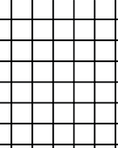
Worked example
Find the resultant vector from this diagram.
Suitable scale: 1cm = 5N
65 N
19.2 cm = 5 x19.2 = 96N
80º
Angle from the first vector = 31◦
19.2 cm
59 N
Notes:
Always follow these steps:
It is best to do this on a visualiser.
The resultant of two (or more) vectors acting perpendicular to each other can be determined using a scale drawing.
Step 1: In the same way that we choose a suitable scale for perpendicular vectors, we do the same here. A suitable scale here may be 1 cm = 5 N, but there are a few different options that could be chosen.
Step 2: Draw the first vector using the scale. We can start with 30 N, so will draw a line of 6 cm.
Step 3: Measure the angle between the vectors and mark this on your page.
Step 4: Draw the second vector using this measured angle and your chosen scale, in this case 45 N will mean a line of length 9 cm.
Step 5: Draw lines that are parallel to each of the vectors, thereby creating a parallelogram.
Step 6: Measure the length from the origin to the tip of the new parallelogram - this is the resultant. Use the scale to determine its real magnitude. In this case the length (blue arrow) is 14.7 cm so using the scale gives a resultant with magnitude 73.5 N.
Step 7: Use a protractor to measure the angle or bearing of the resultant. It is easiest to describe as x of horizontal or x of vertical so you may want to mark on a dotted horizontal or vertical line to measure from. In this case our 30 N force was 10º below horizontal so we can include this in our answer. The angle of this resultant vector is 28º below horizontal.
Note: you may want to remove the angles from this example for weaker ability classes - it is rare that pupils are asked to give more than the magnitude for non-perpendicular vectors in exam questions.
A good way to check that you have your magnitude correct is that if the two vectors were acting in the same direction they would have the maximum resultant, so your measured resultant can never be greater than this.

Slide 10
Vector Diagrams
Use a scale drawing to determine the resultant vector from each of the following pairs:
1.
65 N
2.
3.
80º
53 N
45 N
40 N
48º
46 N
13º
59 N
Resultant = 96 N
Resultant = 92 N
Resultant = 78 N
Notes:
This is best done under a visualiser and can be used as an additional I/We/You cycle

Slide 11
What single vectors could have produced this resultant?
Which directions would the single forces have been acting in?
Would these forces have been the same size?
What would a free-body force diagram of the single forces look like?
5 N
37º
Notes:
This diagram shows a resultant force of 5 N, acting at an angle of 37º.
Which directions must the single vectors have been acting in to produce a vector that is pointing up and right?
One must have been acting upwards and the other acting towards the right.
These are what we can call our ‘components’ - the horizontal and vertical single vectors that have made up our resultant.
We can also tell straight away that the forces acting upwards and to the right cannot be the same as each other, otherwise the resultant would fall exactly between them and act at an angle of 45º (as this is half of 90º, which is angle between the single vector components).

Slide 12
Resolving Vectors
Higher Tier only
The components of a resultant vector acting at an angle can be determined using a scale drawing.
Choose a suitable scale to use for the scale drawing (e.g. 1 N = 1 cm)
Use a protractor to measure the given angle and mark this on your page
Use your scale to draw the resultant at this angle
Draw dotted lines to make a right-angled triangle on either side of the resultant (which together make a rectangle)
Measure the length of the horizontal and vertical components
Use your scale to determine the actual magnitudes of these components and give their directions
37º
5 N
4 N
3 N
Notes:
Exposition type: explanation
Ideally this should be done live on a whiteboard and you may want to get pupils to draw each step along with you in their books.
Suggested Exposition:
We know that two vectors can be combined into a resultant vector that has the same effect. But what happens when we have the resultant vector to start with? We are going to work backwards and determine the single vectors that our resultant vector must be made up of.
So what do we do? We can use the same steps but work backwards to determine our components!
Step 1: Determine a suitable scale - exactly the same way that we chose a scale in the last lesson, we will do the same here. A sensible scale to use here could be 1 N = 1 cm.
Step 2: Measure the angle given using a protractor and mark this neatly on your page.
Step 3: Use your scale to draw the resultant with the correct magnitude (in this case 5 cm) at the angle that you marked out.
Step 4: Use a ruler to draw dotted lines to make a right-angled triangle on either side of the resultant, giving a full rectangle (it should look like the vector diagrams from last lesson)
Step 5: Measure the length of the horizontal and vertical components that come from the point of origin of the resultant.
Step 6: Use your scale to determine the actual magnitudes of these single vectors and describe them as the horizontal and vertical components.
Horizontal line = 3 cm so the horizontal component is 3 N right.
Vertical line = 4 cm so the vertical component is 4 N up.
Remember these are still single vectors and vectors need to have a direction so our answer should have the directions of the components too.
Sometimes you may be asked to draw a free-body force diagram to show where the forces are acting from. We can use this triangle method to determine our resultant but both forces would still act from the point of origin (the centre of mass) of the object, so we can draw them in our free-body force diagram as normal, using our triangle to remind us of the direction of their actions.

Slide 13
Resolving Vectors
Use a scale drawing to resolve the resultant vector into its horizontal and vertical components.
An object has a resultant force of 10 N at an angle of 30º below horizontal.
30º
10 N
1 N = 1 cm
30º
10 N
Notes:
Exposition type: demonstration
Ideally get pupils to draw along in their books with each step so they can practice slowly before they try it independently.
Suggested exposition:
Let’s follow the same steps again to resolve this resultant vector into its horizontal and vertical components.
Step 1: Determine a suitable scale. A sensible scale to use here could be 1 N = 1 cm.
Step 2: Measure the given angle using a protractor and mark this neatly on your page. This time our angle is below horizontal so we can draw a horizontal line as reference.
Step 3: Use your scale to draw the resultant with the correct magnitude (in this case 10 cm) at the angle that you marked out.
Step 4: Use a ruler to make two right-angled triangles.
Step 5: Measure the length of the horizontal and vertical components.
Step 6: Use your scale to determine the actual magnitudes of these single vectors and describe them as the horizontal and vertical components.
Vertical line = 4.4 cm so the vertical component is 4.4 N down.
Horizontal line = 9.1 cm so the horizontal component is 9.1 N right.

Slide 14
I: Worked example
Resolve this vector into its components.
50 N
25 N
30º
43.3 N
Notes:
Allow an appropriate margin for error that corresponds to the scale
Always follow these steps:
It is best to do this on a visualiser.
The components of a resultant vector acting at an angle can be determined using a scale drawing.
Choose a suitable scale to use for the scale drawing (e.g. 1 N = 1 cm)
Use a protractor to measure the given angle and mark this on your page
Use your scale to draw the resultant at this angle
Draw dotted lines to make a right-angled triangle on either side of the resultant (which together make a rectangle)
Measure the length of the horizontal and vertical components
Use your scale to determine the actual magnitudes of these components and give their directions

Slide 15
We: Worked example
Resolve this vector into its components.
105.2 N
20º
38.3 N
112 N
Notes:
Always follow these steps:
It is best to do this on a visualiser.
The components of a resultant vector acting at an angle can be determined using a scale drawing.
Choose a suitable scale to use for the scale drawing (e.g. 1 N = 1 cm)
Use a protractor to measure the given angle and mark this on your page
Use your scale to draw the resultant at this angle
Draw dotted lines to make a right-angled triangle on either side of the resultant (which together make a rectangle)
Measure the length of the horizontal and vertical components
Use your scale to determine the actual magnitudes of these components and give their directions

Slide 16
You: Worked example
Resolve this vector into its components.
61.3 N
40º
51.4 N
80 N
Notes:
Always follow these steps:
It is best to do this on a visualiser.
The components of a resultant vector acting at an angle can be determined using a scale drawing.
Choose a suitable scale to use for the scale drawing (e.g. 1 N = 1 cm)
Use a protractor to measure the given angle and mark this on your page
Use your scale to draw the resultant at this angle
Draw dotted lines to make a right-angled triangle on either side of the resultant (which together make a rectangle)
Measure the length of the horizontal and vertical components
Use your scale to determine the actual magnitudes of these components and give their directions

Slide 17
Determine the missing words needed to complete each sentence:
Resultant vectors acting at an angle can be resolved into ______________ and _____________ components.
All scale drawing should have a ____________ and be drawn using a ___________ and a __________.
A ___________ should be used to measure angles.
Components should be described with both _______________ and _____________.
horizontal
vertical
scale
pencil
ruler
protractor
magnitude
direction
Notes:
Purpose: review of new information.

Slide 18
Drill
What is a component?
How do you calculate the resultant vector if they are acting in the same direction? If the vectors are acting in opposite directions, how do you calculate the resultant vector?
Draw perpendicular lines.
If the vectors are acting perpendicular to each other how do you find the resultant vector? When you have measured your resultant vector length with a ruler how do you convert it to the real magnitude? Where must you measure the angle of your resultant vector when using perpendicular vectors?
What is the difference in finding a resultant vector from perpendicular and non-perpendicular lines?
Where would you start measuring the angle of the resultant line in this diagram?
Notes:
Purpose: This is a knowledge drill. The purpose of this is to check that the critical knowledge is secure before pupils move onto independent practice.
Suggested guidance: There are a range of ways this could be done depending on time and ability range of the class:
Mini whiteboards
As full sentences in exercise books
As short answers in exercise books
In the pupil workbook
As pair talk
As cold call

Slide 19
Drill answers
A single horizontal or vertical vector.
Add up vectors acting in the same direction.
Subtract vectors acting in the opposite directions
Diagram
Draw scale drawings for vectors that are perpendicular.
To convert your length to the real magnitude, look at the scale and multiply it by your length. (Scale x length) You always measure the angle from your first vector.
With non-perpendicular you start from the y axis . With perpendicular you start from the first vector.
From the y axis
Notes:
Purpose: This is a knowledge drill. The purpose of this is to check that the critical knowledge is secure before pupils move onto independent practice.
Suggested guidance: There are a range of ways this could be done depending on time and ability range of the class:
Mini whiteboards
As full sentences in exercise books
As short answers in exercise books
In the pupil workbook
As pair talk
As cold call

Slide 20
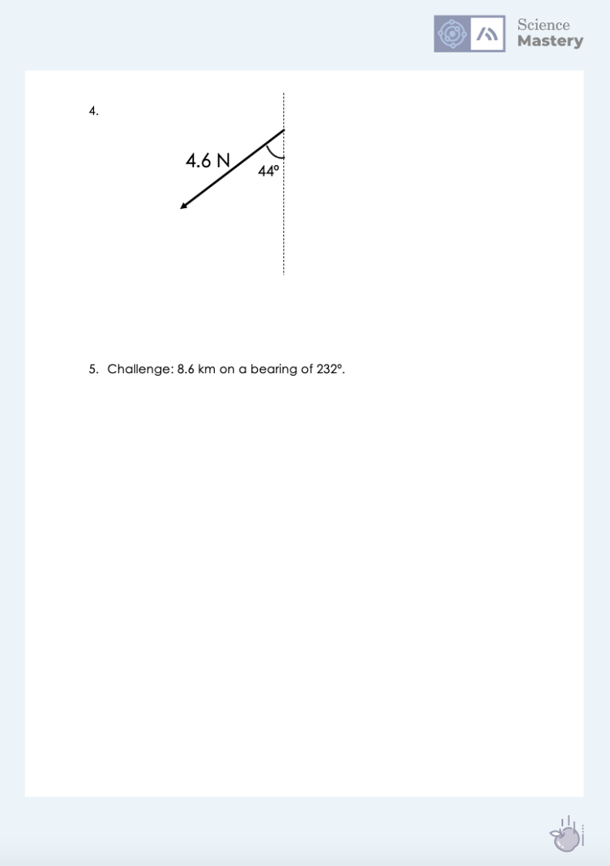
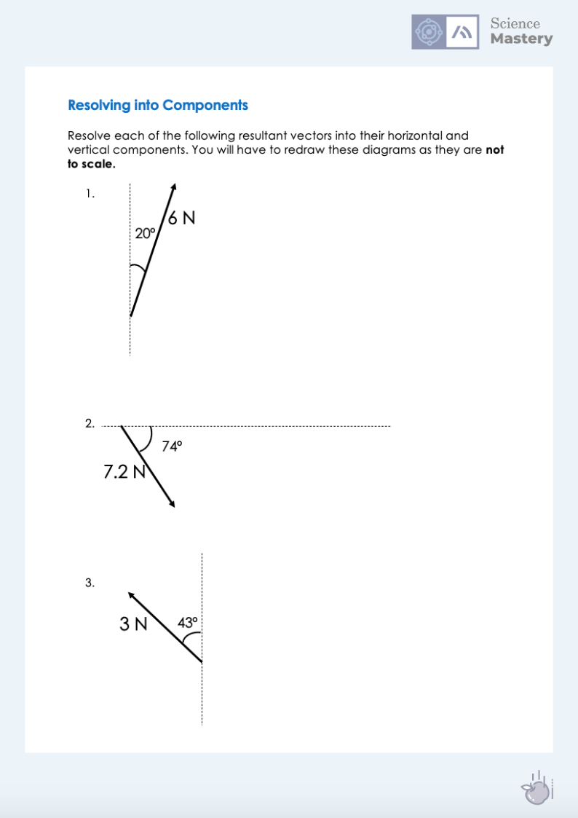
Resolving Vectors
Complete the scale drawing activity.
Make sure you state your scale and use a ruler and pencil.
Ensure your components are described with magnitude and direction.
Notes:
Purpose: practice application of new knowledge.

Slide 21
Answer the questions below.
1. What is the difference between scalars and vectors?
A. Scalars always have a direction
B. Vectors always have a direction
C. Vectors sometimes have a direction
2. Which are the most likely components of this resultant vector?
A. 20 N up and 15 N right
B. 8 N right and 6 N up
C. 5 N right and 15 N down
3. Which is most likely to be the resultant of these single vectors?
A. 18 N
B. 2 N
C. 13 N
✓
✓
10 N
8 N
✓
6 N
Notes:
Suggested Guidance:
Q1. Answer: B
If students answered A or C, they are not secure on the difference between scalars and vectors. To fix-it, explain the difference between each using examples and how vector quantities are written as answers.
Q2. Answer: B
If students answered A, they have understood the relative directions that would produce this resultant but not understood that the components could not be larger than the resultant as it would form the hypotenuse of a triangle. If students answered C, they have simply found the difference between the values. To fix-it, it may be worth going through the method again or getting pupils to look at the relative values of their components compared to the resultants.
It may be useful to go through the different scenarios with vectors being combined and show them this working mathematically – i.e. two vectors acting in the same direction will produce the maximum resultant vector, two acting in opposite directions would produce the minimum vector.
Q3. Answer: C
If students answered A, they have assumed these vectors are acting in roughly the same direction so can still be added together. If students answered B, they have mistakenly subtracted the vectors. To fix-it, you may want to go through with pupils the different combinations of these vectors that would produce each of the resultant options.

Slide 22
Lesson P3.1.4
What was good about this lesson? | What can we do to improve this lesson?
Send us your feedback by clicking this link
or by emailing sciencemastery@arkonline.org
Thank you!

